Slide 1
Map (Room/Terrain) Synthesis for
Low-Poly 3D Scenes
Tobias Christoph
Supervisor:
Stephanie Autherith
Research Group:
Interactive Graphic and Simulation Group

Slide 2
Introduction
Procedural Content Generation (PCG)

Slide 3
Introduction
Procedural Content Generation (PCG)
Manual creation can be tedious

Slide 4
Introduction
Procedural Content Generation (PCG)
Manual creation can be tedious
Algorithmic process

Slide 5
Introduction
Procedural Content Generation (PCG)
Manual creation can be tedious
Algorithmic process
Video Games

Slide 6
Introduction
Procedural Content Generation (PCG)
Manual creation can be tedious
Algorithmic process
Video Games
Textures, models, sounds

Slide 7
Introduction
Procedural Content Generation (PCG)
Manual creation can be tedious
Algorithmic process
Video Games
Textures, models, sounds
Maps

Slide 8
Introduction
Procedural Content Generation (PCG)
Manual creation can be tedious
Algorithmic process
Video Games
Textures, models, sounds
Maps
Machine Learning

Slide 9
Introduction
Procedural Content Generation (PCG)
Manual creation can be tedious
Algorithmic process
Video Games
Textures, models, sounds
Maps
Machine Learning
Generative Adversarial Networks (GAN)

Slide 10

Goal
Input:
‘Traversability’-Sketch

Slide 11
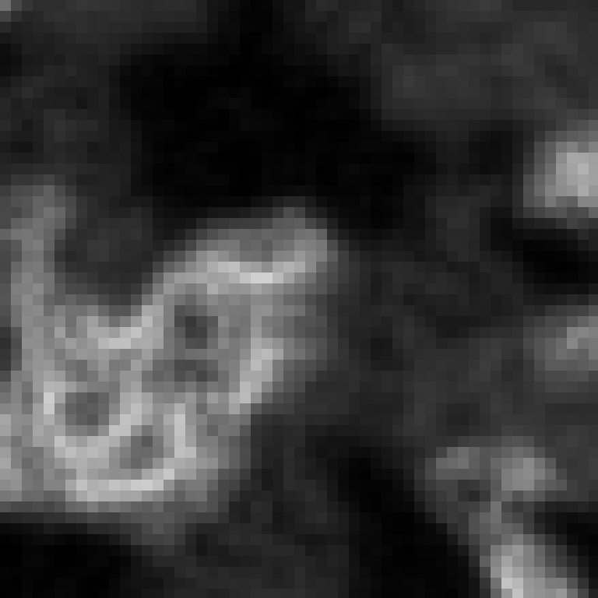

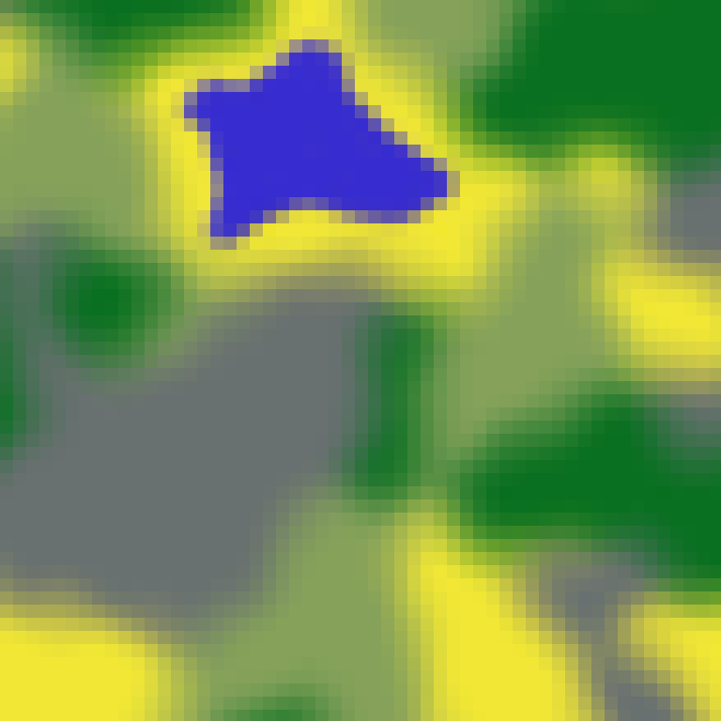
Goal
Height-Map
Input:
‘Traversability’-Sketch
Biome-Map

Slide 12
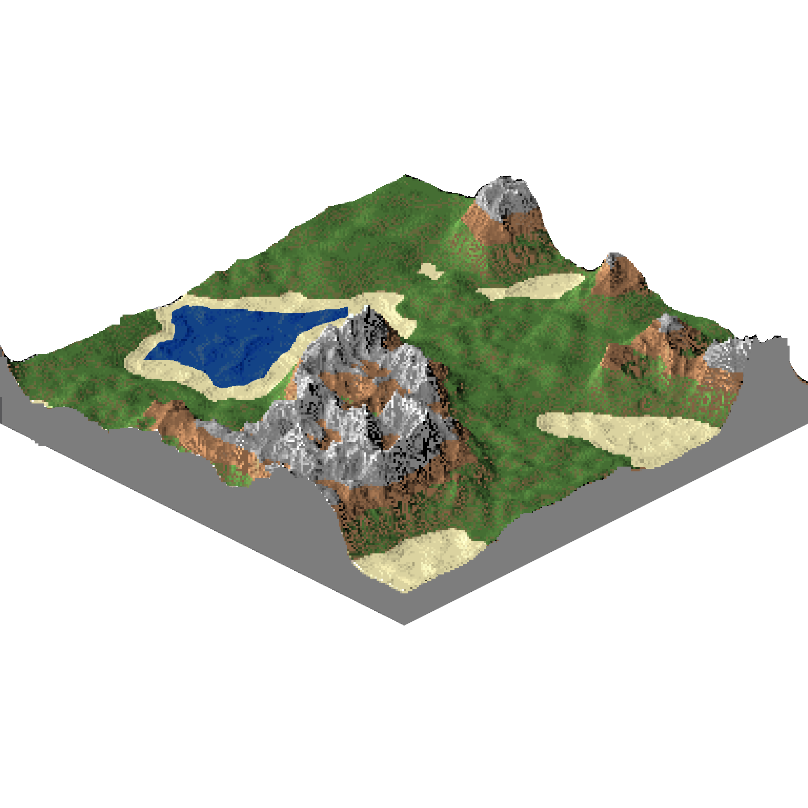
Goal
Height-Map
Input:
‘Traversability’-Sketch
Playable Game Map
Biome-Map

Slide 13
Main Tasks
Dataset Creation

Slide 14

Main Tasks
Dataset Creation
Height map with a corresponding biome map

Slide 15
Main Tasks
Dataset Creation
Height map with a corresponding biome map
Create ‘traversability-map’ representing training data
IMAGE

Slide 16
Main Tasks
Dataset Creation
Height map with a corresponding biome map
Create ‘traversability-map’ representing training data
Generative Adversarial Networks (GAN)

Slide 17
Main Tasks
Dataset Creation
Height map with a corresponding biome map
Create ‘traversability-map’ representing training data
Generative Adversarial Networks (GAN)
Conditional GAN (cGAN)

Slide 18
Main Tasks
Dataset Creation
Height map with a corresponding biome map
Create ‘traversability-map’ representing training data
Generative Adversarial Networks (GAN)
Conditional GAN (cGAN)
Pix2Pix

Slide 19
Main Tasks
Dataset Creation
Height map with a corresponding biome map
Create ‘traversability-map’ representing training data
Generative Adversarial Networks (GAN)
Conditional GAN (cGAN)
Pix2Pix
3D Rendering of the Map

Slide 20
Generative Adversarial Networks

Slide 21
Generative Adversarial Networks
Invented by Ian Goodfellow in 2014

Slide 22
Generative Adversarial Networks
Invented by Ian Goodfellow in 2014
Idea: create similar but novel data

Slide 23
Generative Adversarial Networks

Slide 24
Generative Adversarial Networks

Slide 25
Generative Adversarial Networks

Slide 26
Generative Adversarial Networks

Slide 27
Generative Adversarial Networks

Slide 28
Conditional Generative Adversarial Networks

Slide 29
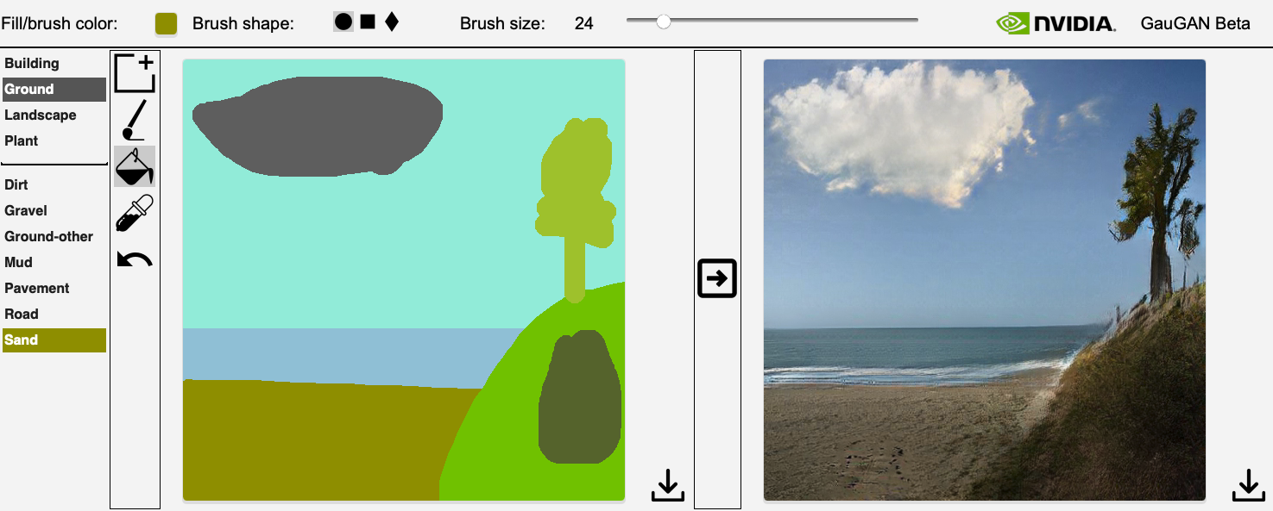
Example – Nvidia GauGAN Beta

Slide 30




Technologies
Programming Language
Python
Frameworks
PyTorch
Tensorflow
Rendering Software
Unity Engine

Slide 31
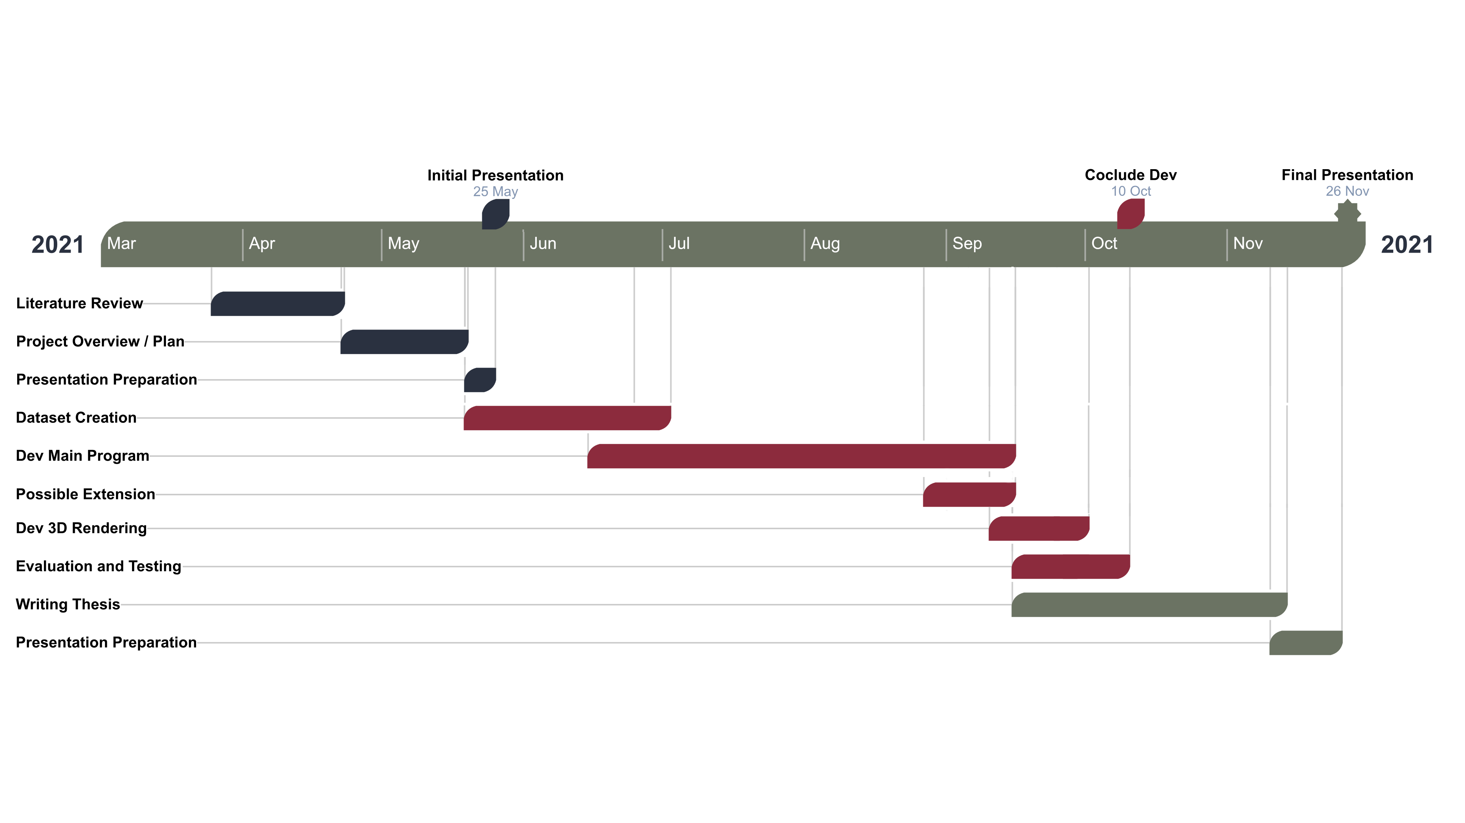
Timeline

Slide 32
References
[Liapis A., Yannakakis G.N., Togelius J. 2013] - Sentient World: Human-Based Procedural Cartography. In: Machado P., McDermott J., Carballal A. (eds) Evolutionary and Biologically Inspired Music, Sound, Art and Design. EvoMUSART 2013.
[Ping K., Dingli L. 2020] - Conditional Convolutional Generative Adversarial Networks Based Interactive Procedural Game Map Generation. In: Arai K., Kapoor S., Bhatia R. (eds) Advances in Information and Communication. FICC 2020. Advances in Intelligent Systems and Computing, vol 1129
[NoisePosti.ng] – A Procedural Generation and Game Development blog, link: https://noiseposti.ng/posts/2021-03-13-Fast-Biome-Blending-Without-Squareness.html
[Nvidia GauGAN] – link: http://nvidia-research-mingyuliu.com/gaugan/
[Tensorflow] – link: https://www.tensorflow.org
[Python] – link: https//www.python.org
[PyTorch] – link: https://pytorch.org
[Unity] – link: https://unity.com

Slide 33
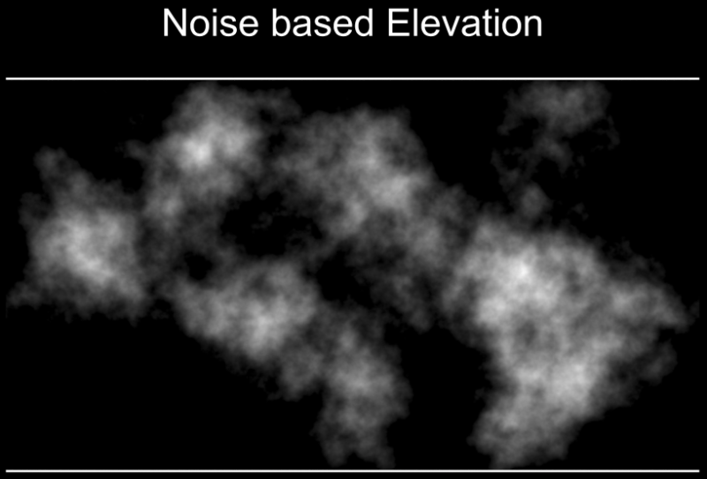
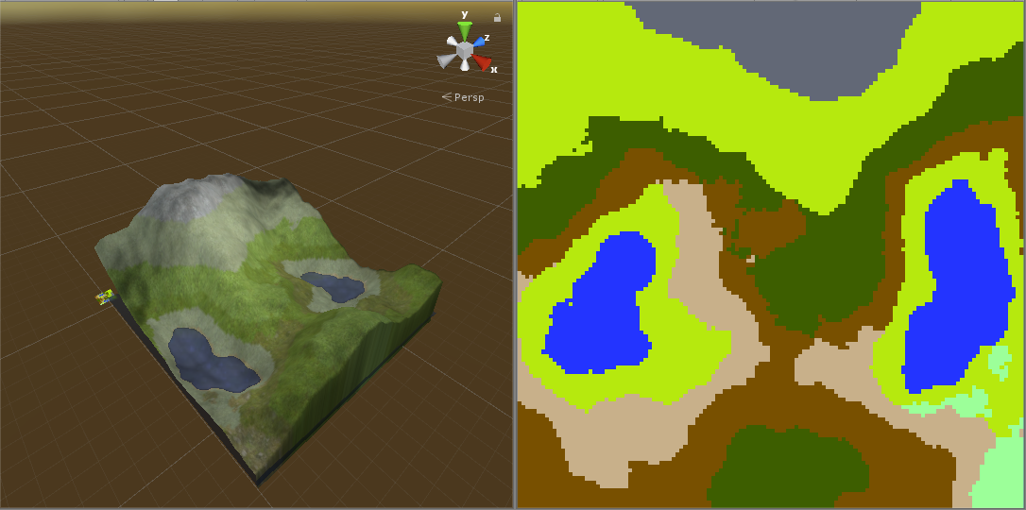
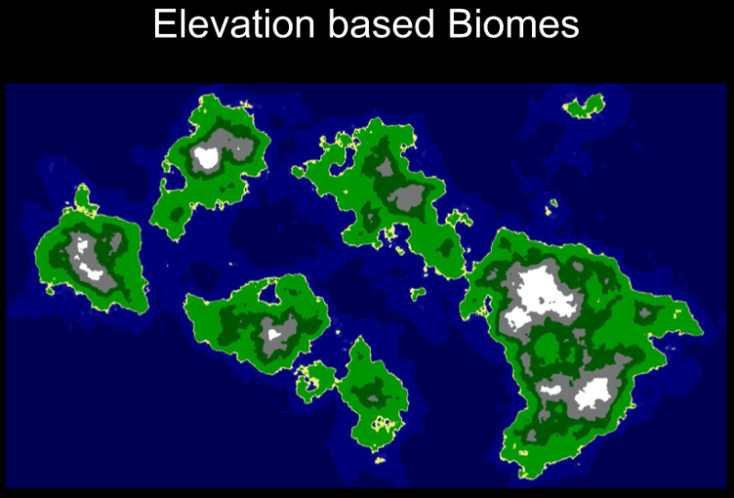
Misc – 1 Height + Biome Map
https://github.com/pecarprimoz/procedural-gen-dipl
https://tenjix.de/projects/climate-based-biomes/

Slide 34
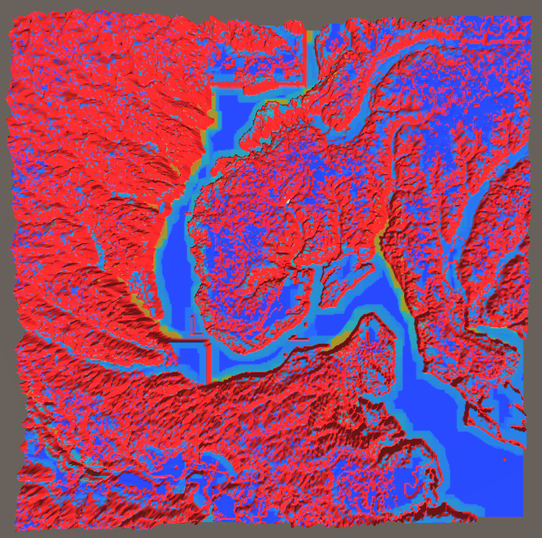
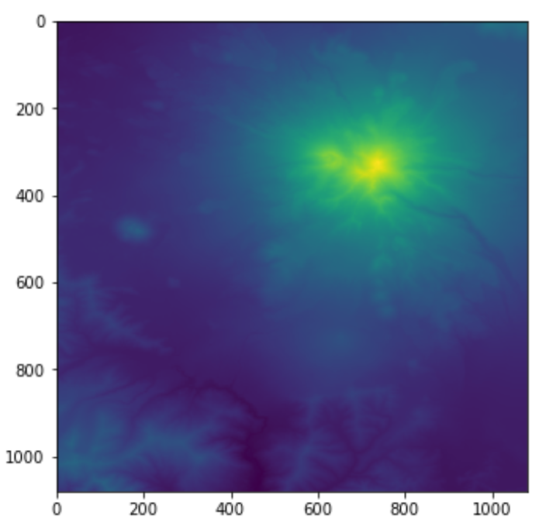
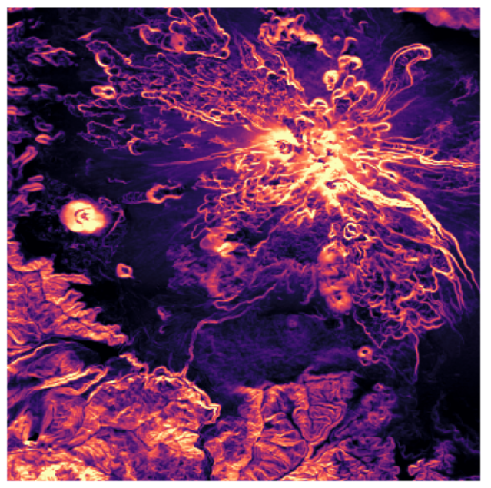
Misc – 2 Traversability Map
Rough Terrain Exploration With a Legged Humanoid Robot - https://github.com/misha-savchenko/Footstep_planner
Calculating slope and aspect from a digital elevation model in Python – Matt Oakley, Max Joseph - https://www.earthdatascience.org/tutorials/get-slope-aspect-from-digital-elevation-model/
Elevation (brighter = higher)
Slopes (brighter = steeper)

